Slide 2
WELCOME

Slide 3
Recreational Vehicle Product Suite

Slide 4

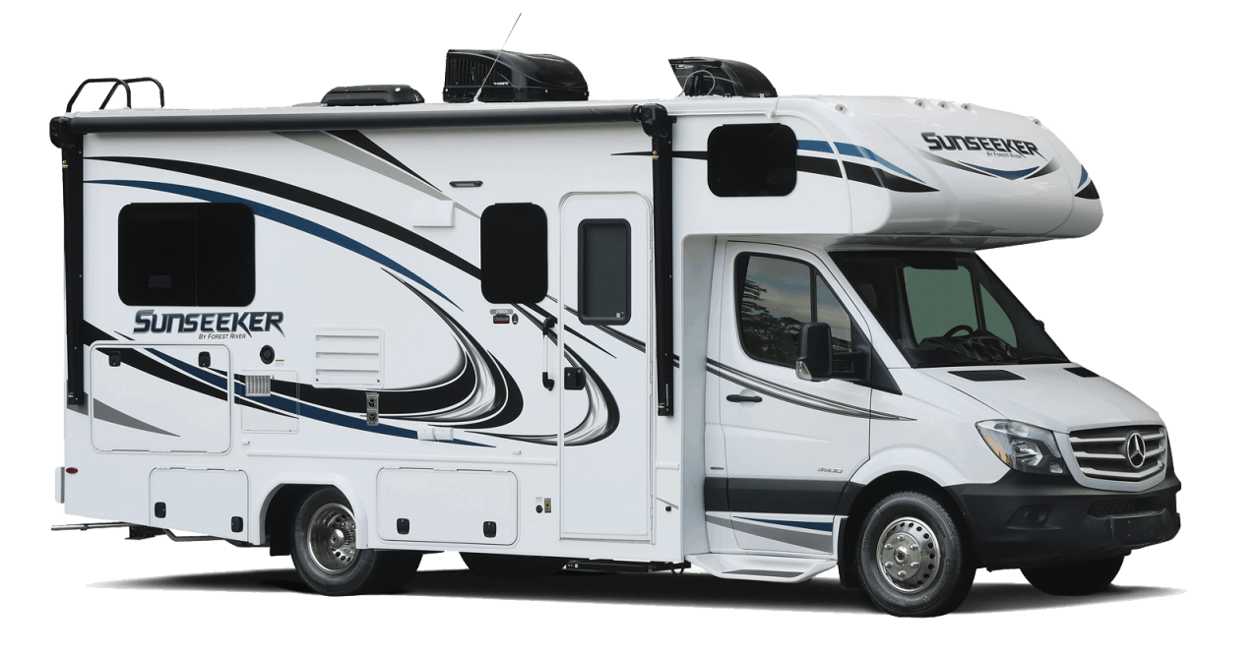
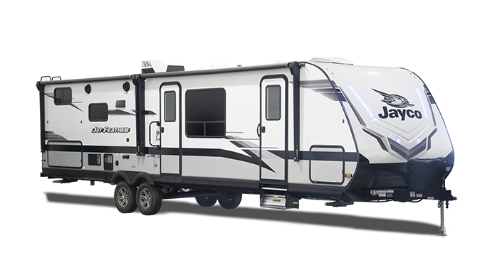
iA AMERICAN RV PRODUCT SUITE
Vehicle Service Contracts
Limited Warranty
GAP
Tire and Wheel
Theft
Interior / Exterior
*All products are underwritten by DAC
For illustrative purposes only – images are the property of their respective owners

Slide 5
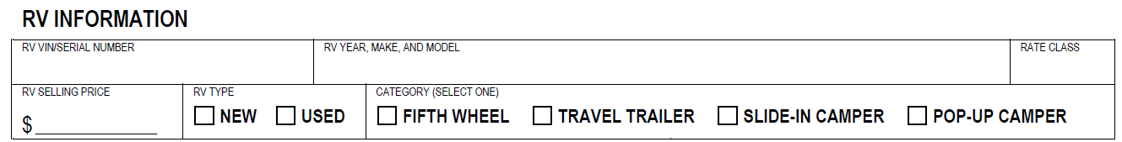
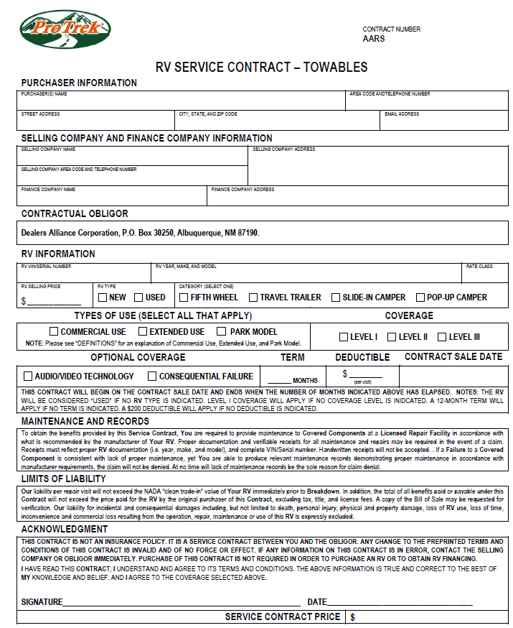
RV VSC – TOWABLES – ELIGIBILITY
“New” Eligibility
Up to 5 years old
3-5 age surcharges
12, 24, 36, 48, 60, 72, 84-month terms
Must retain some portion of factory warranty
Does not have a branded or salvaged title
Does not have any modifications that are not approved by the factory

Slide 6
RV VSC – TOWABLES – ELIGIBILITY
“Used” Eligibility
Up to 14 years old
8-14 age surcharges
12, 24, 36, 48, 60-month terms
Does not have a branded or salvaged title
Does not have any modifications that are not approved by the factory

Slide 7
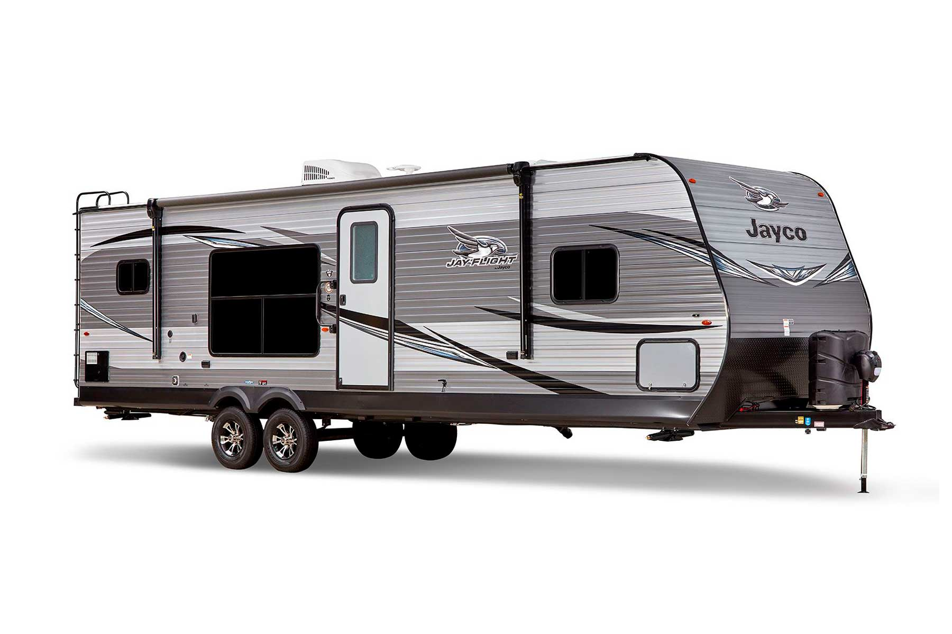
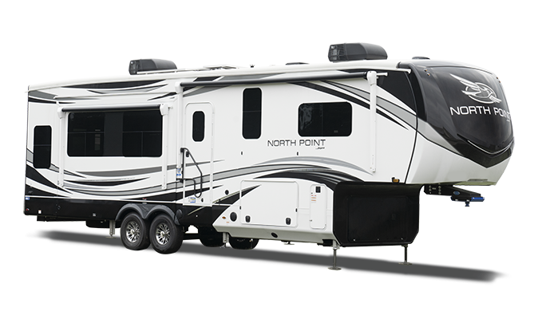
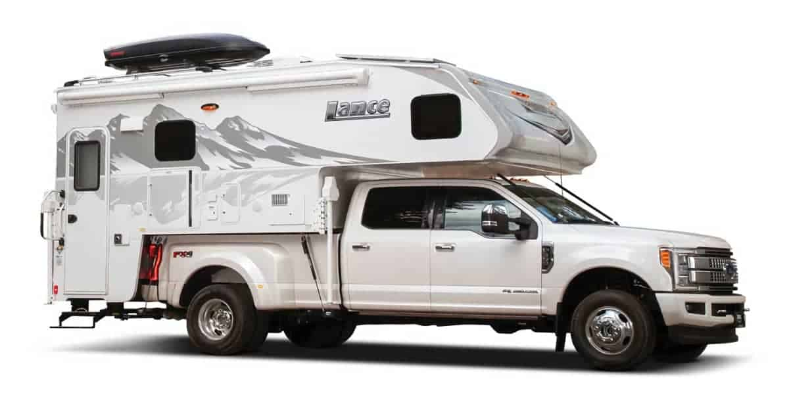
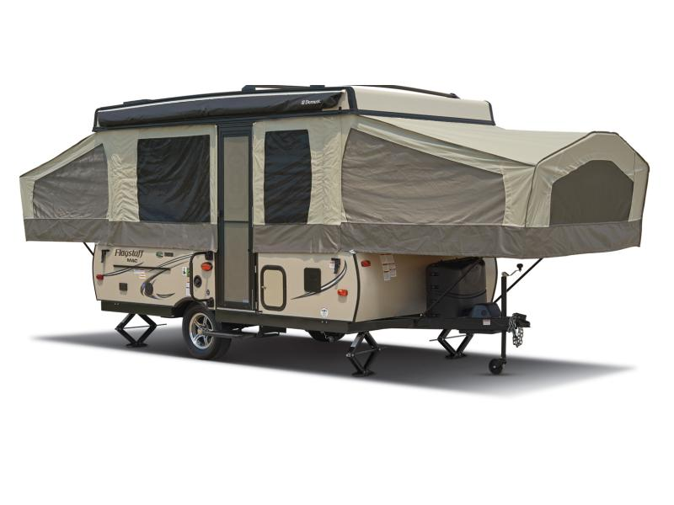
RV VSC – TOWABLES – ELIGIBILITY
Fifth Wheel
Travel Trailer
Pop-Up Campers
Slide-In Campers
For illustrative purposes only – images are the property of their respective owners

Slide 8
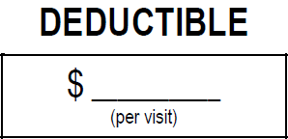
RV VSC – TOWABLES – ELIGIBILITY
$100 is standard
$0
$50
$200
$500

Slide 9

RV VSC – TOWABLES – COVERAGES
LEVEL I – STATED
Suspension components:
Spindles
Wheel bearings
Coil and leaf springs
Rubberized suspension items
Actuators
Axle shafts

Slide 10
RV VSC – TOWABLES – COVERAGES
LEVEL I – STATED
Brake system components:
Master cylinder
Backing plates
Drums
Rear actuators

Slide 11
RV VSC – TOWABLES – COVERAGES
LEVEL I – STATED
Chassis frame:
Spring hangers
Hub
Couplers
Metal frame
Landing gear
Brackets
Winch stand
Coupler
Lift crank
Assembly for pop-up
Master cylinder
Backing plates
Drums
Rear actuators

Slide 12
RV VSC – TOWABLES – COVERAGES
LEVEL I – STATED
Water heater components:
Burner assembly
Water tank
Thermostat
Thermocouple
Pressure valve
Gas valve
Heating elements
Electronic ignition assembly
Wiring harness
Switches
Fittings and connectors
Control panel
Circuit boards

Slide 13
RV VSC – TOWABLES – COVERAGES
LEVEL I – STATED
Waste system components:
Shower
Toilet(s)
Sink(s)
Holding tank
In-sink disposal
Pipes
Traps
Gate valves
Fittings and connectors

Slide 14
RV VSC – TOWABLES – COVERAGES
LEVEL I – STATED
Fresh water system components:
Fresh water pump
Compressor
Faucet(s)
Water tank
Water lines
Traps
Fittings and connectors

Slide 15
RV VSC – TOWABLES – COVERAGES
LEVEL I – STATED
Air conditioning/ventilation components (roof-mounted):
Ducts
Switches
Compressor
Evaporator
Capacitors
Relays
Thermostat
Heat strips
Heating element(s)
Heat pump
Condense
Accumulator
Expansion valve
Receiver drier
Blower motor
Electronic module
Circuit boards
Cycling switches
Pressure switches
Ventilation fans
Control panel

Slide 16
RV VSC – TOWABLES – COVERAGES
LEVEL I – STATED
Range and oven components:
Burner assembly
Thermostat
Thermocouple
Burner valves
Convection oven
Microwave oven
Power hood
L.P. lines
L.P. fittings and connectors
Circuit boards

Slide 17
RV VSC – TOWABLES – COVERAGES
LEVEL I – STATED
L.P. gas system components:
Valves
Regulators
Gauges
Mounting brackets
Pigtails
Gas bottles
L.P. lines
Fittings and connectors
Shut-off system

Slide 18
RV VSC – TOWABLES – COVERAGES
LEVEL I – STATED
Heating system components:
Furnace igniter
Burner assembly
Thermocouple
Gas valve
Thermostat
Blower motor
Heat pump
Heat strips
L.P. fittings and connectors
Control panel
Circuit boards

Slide 19
RV VSC – TOWABLES – COVERAGES
LEVEL I – STATED
Refrigerator components:
Thermostat
Thermocouple
Cooling unit
Burner assembly
Igniter
L.P. fittings and connectors
Control panel
Latch and door seals
Circuit boards

Slide 20
RV VSC – TOWABLES – COVERAGES
LEVEL I – STATED
Power step components:
Power step system
Note: Coverage is available only for systems that are factory installed or dealer installed and approved by the factory.

Slide 21
RV VSC – TOWABLES – COVERAGES
LEVEL I – STATED
A/V system:
TV
Stereo system
Amplifiers
Speakers
CD/cassette player
Antenna motor
Antenna and rotor package
Antenna control panel
Antenna signal amp

Slide 22
RV VSC – TOWABLES – COVERAGES
LEVEL I – STATED
Deluxe component package:
Awning mechanism (excludes cover)
Door hinge(s)
Door handle(s)

Slide 23
RV VSC – TOWABLES – COVERAGES
LEVEL II – STATED
Includes all coverage for all of the components listed in “Level I”

Slide 24
RV VSC – TOWABLES – COVERAGES
LEVEL II – STATED
Auxiliary powerplant components:
Starter
Switches
Ignition coil
Generator assembly
Power converter
Inverter
Voltage regulator
Gauges
Shore power cord and reel
Interior monitor/ control panel
Circuit boards
All internal lubricated parts of the powerplant engine
The cylinder head and block are covered if damaged by the failure of an internal lubricated part

Slide 25
RV VSC – TOWABLES – COVERAGES
LEVEL II – STATED
Leveling system:
Motor
Hydraulic/ electric pump
Actuator
Jack(s)
Line(s)
Fitting(s)
Power cylinder(s)
Worm gear
Gear sets
Switch(es)
Wiring harness

Slide 26
RV VSC – TOWABLES – COVERAGES
LEVEL II – STATED
Slide-out room:
Motor assembly
Hydraulic/ electric pump
Jack(s)
Line(s)
Fitting(s)
Power cylinder(s)
Worm gear
Gear sets
Switch(es)
Wiring harness
Weather seals

Slide 27
RV VSC – TOWABLES – COVERAGES
Deluxe component package:
Rear monitoring system
Ice maker
Dishwasher
Washer/dryer (excludes belts and hoses)
Trash compactor
Central vacuum system
Systems monitor panel
Carbon monoxide sensor
Smoke sensor
Thermometer compass
Central locking system
Power seat system
Awning motor
Awning weather sensor
Awning control panel
Wonder bead lift motor and switch
Interior/exterior light assemblies
Switches
Electrical outlet(s)
External barbeque grill
Kitchen center (factory-installed)

Slide 28
RV VSC – TOWABLES – COVERAGES
LEVEL III
Exclusionary coverage

Slide 29
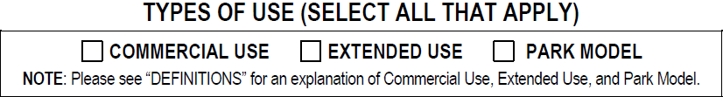
RV VSC – TOWABLES – COVERAGES
Commercial use:
Usage in exchange for any charge, fare, fee, rate, or any other consideration, or any other usage intended for profit
RVs displaying advertising signage
RVs owned by businesses
Commercial farm operation
RVs with commercial license plates are considered commercial use vehicles
Commercial ridesharing/ ride-hailing services

Slide 30
RV VSC – TOWABLES – COVERAGES
Commercial use (cont.):
Commercial towing
Construction
Delivery
Livery
Repair work
Route work
Service work
Shuttle, taxi, or vehicle rental
Usage must not exceed manufacturer’s ratings and/or limitations

Slide 31
RV VSC – TOWABLES – COVERAGES
Extended use:
Used for 185 days or more per year

Slide 32
RV VSC – TOWABLES – COVERAGES
Park model:
A towable RV designed to provide temporary living quarters for recreational, seasonal, camping, or travel use
Park models must be built to the American National Standards Institute (ANSI) A119.5 standard for park trailers
In addition, the park model must be mounted on wheels with a gross trailer area not to exceed 400 square feet

Slide 33

RV VSC – TOWABLES – COVERAGES
Audio/video technology:
TVs
Audio/video headphones
Cellular phones and phone systems
CB radio
Internet and satellite communication system access devices
Video game systems
iPod/MP3 or similar portable music/video players
Audio/video cabling and hubs
VCRs
DVD players
Blu-ray players
Home theater audio systems
Satellite dish
Control panel and switches
Converter and in-motion satellite receiver
GPS or navigation system
Personal computer tower
One (1) personal computer monitor

Slide 34
RV VSC – TOWABLES – COVERAGES
Consequential failure:
If you select this option, we will reimburse you for the cost to repair or replace selected parts or components, if such parts or components fail or become damaged due to the mechanical breakdown of a covered part
The parts or components we cover under this option are limited to the following: batteries, belts, brake linings or shoes brake pads, brake drums and rotors, electric motors used to power the RV, fuses, glass lenses, hoses, light bulbs, manual and hydraulic linkages, rainwater collection and filtration systems, shock absorbers, solar panels, and the wind turbine

Slide 35
TOWABLES – ANCILLARY BENEFITS
Service Call Reimbursement
Up to $200 per visit
Pays toward a service technician visiting to fix or replace a covered part
Trip Interruption
$200 a day for five (5) days
Not to exceed $1,000
More than 100 miles from your place of residence

Slide 36
TOWABLES – ANCILLARY BENEFITS
Emergency Transportation (Rental Car, Airfare)
Airfare benefits are limited to $275 per person and a maximum of $825 per claim.
Emergency rental car benefits are limited to $325 per claim (one-way or round-trip rental, including fuel)
Must be 100 miles away from your place of residence

Slide 37
TOWABLES – ANCILLARY BENEFITS
Emergency Roadside Assistance
Up to $1,000 per claim
Towing
Flat-tire change
Lock-out

Slide 38
TOWABLES – ANCILLARY BENEFITS
Food Spoilage
Up to $125 per occurrence
Fuel/L.P. Gas (draining)
$200 per occurrence

Slide 39
TOWABLES – ANCILLARY BENEFITS
Pet Benefit
We will reimburse you for actual expenses incurred for pet removal, transporting, handling, and boarding (including hotel/motel pet surcharges), not to exceed $100 per day for up to five (5) days, and a total of $500 per claim, while your RV is being repaired
Applies only to domestic animals and horses

Slide 40
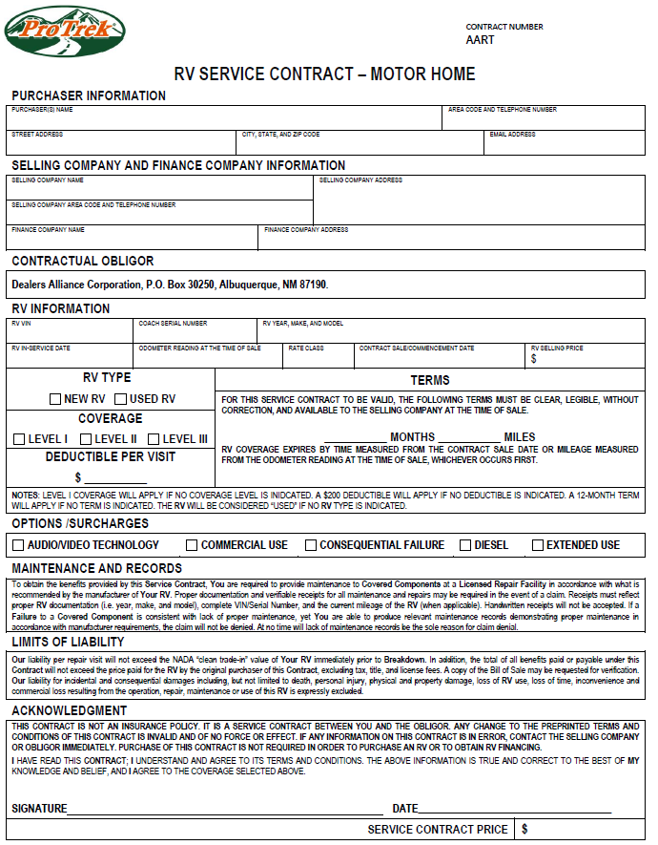

RV VSC – MOTOR HOME – ELIGIBILITY
“New” Eligibility
Up to 6 years old
Must have 50,001 miles or less
Does not have a branded or salvaged title
Has not been altered, modified, or used in a manner not recommended by the manufacturer, including the use of non-stock or modified parts
Must not be registered outside the United States
Does not have an odometer that has been tampered with, altered, disconnected, or not maintained

Slide 41
RV VSC – MOTOR HOME – ELIGIBILITY
“Used” Eligibility
Up to 14 years old
9-14 age surcharges
Less than 100,000 miles
Does not have a branded or salvaged title
Has not been altered, modified, or used in a manner not recommended by the manufacturer, including the use of non-stock or modified parts
Must not be registered outside the United States
Does not have an odometer that has been tampered with, altered, disconnected, or not maintained

Slide 42
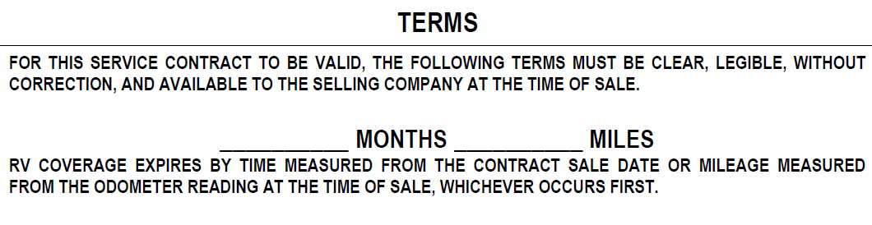
RV VSC – MOTOR HOME – NEW
Term Options
12 months – 15k, unlimited miles
24 months – 30k, unlimited miles
36 months – 40k, unlimited miles
48 months – 50k, unlimited miles
60 months – 50k, 75k, unlimited miles
72 months – 60k, 80k, unlimited miles
84 months – 50k, 75k, 100k, unlimited miles

Slide 43
RV VSC – MOTOR HOME – USED
Term Options
12 months – 12k, unlimited miles
24 months – 24k, unlimited miles
36 months – 36k, unlimited miles
48 months – 48k, unlimited miles
60 months – 60k, unlimited miles

Slide 44

RV VSC – MOTOR HOME – DEDUCTIBLE
$100 is standard
$0
$50
$200
$500

Slide 45

RV VSC – MOTOR HOME – COVERAGES
LEVEL I – STATED
Engine components:
Accessory drive pulley
Intake manifold
Exhaust manifolds
Engine mounts
Engine torque strut
Timing cover
Valve cover(s)
Oil pan
Drive belt/timing belt tensioner
Harmonic balancer
Flywheel
Flexplate
Flywheel/flexplate ring gear
Vacuum pump
Dipstick and tube
Pistons
Piston pins
Piston rings
Connecting rods rod bearings
Crankshaft and crank bearings
Camshaft
Camshaft followers and bearings

Slide 46
RV VSC – MOTOR HOME – COVERAGES
LEVEL I – STATED
Engine components (cont.):
Pushrods
Valves, valve springs
Valve guides
Valve seats
Lifters
Rocker arms
Timing gear
Timing chain
Timing belt
Tensioners
Chain retainers
Eccentric shaft
Oil pump
Thermostatically controlled air intake housing
All internal lubricated parts of the engine
Engine head(s) and engine block are covered only if they are damaged by the failure of an internal lubricated part of the engine

Slide 47
RV VSC – MOTOR HOME – COVERAGES
LEVEL I – STATED
Turbocharger components:
All internal lubricated parts of the turbocharger
Wastegate/dump valve
Intercooler
The turbocharger housing is covered if damaged by the failure of an internal lubricated part

Slide 48
RV VSC – MOTOR HOME – COVERAGES
LEVEL I – STATED
Transmission and transfer case:
Cooler line
Transmission park brake assembly and all internal lubricated parts of the transmission and transfer case
Torque converter
Vacuum modulator
Internal linkage
Mounts, oil pan, cooler
Filler tube and dipstick
Transfer case and transfer case housing
NOTE: Transmission case and transfer case housing are covered if damaged by the failure of an internal lubricated part

Slide 49
RV VSC – MOTOR HOME – COVERAGES
LEVEL I – STATED
Transmission and transfer case (cont.):
Propeller shaft
Axle shafts
Constant velocity joints
Universal joints
Drive shafts
Hub/wheel bearings
Supports
Retainers and bearings
All internal lubricated parts contained within the differential housing, 4WD hubs, oil cooler, metal lines, final drive housing, differential housing
The differential housing, transaxle housing, and final drive housing are covered if damaged by the failure of an internal lubricated part

Slide 50
RV VSC – MOTOR HOME – COVERAGES
LEVEL I – STATED
Fuel delivery components:
Fuel pump
Fuel tank(s)
Metal fuel lines
Fuel level sensor
Fuel pressure regulator
Fuel distributor
Fuel injection pump
Fuel injectors
Auxiliary tank switch

Slide 51
RV VSC – MOTOR HOME – COVERAGES
LEVEL I – STATED
Steering components:
Rack and pinion gear
Power steering pump
Fluid reservoir
Pump pulley
Main and intermediate steering column shafts and shaft couplings
Shaft coupling(s)
Tilt/telescoping steering column
Cooler
Cooler lines
Power cylinder
Pitman arm
Idler arm
Tie rod and tie rod ends
Drag links
Bell cranks
Control valve and cylinder
Steering dampener
Housing and all internal lubricated parts of the steering gear box
The gear housing is covered if damaged by the failure of an internal lubricated part

Slide 52
RV VSC – MOTOR HOME – COVERAGES
LEVEL I – STATED
Air conditioning components, dashboard or front:
Compressor
Clutch
Clutch pulley
Clutch coils
Condenser
Evaporator
POA valve
Accumulator
Orifice tube
Expansion valve
Temperature control programmer
Power module
Idler pulley
Idle pulley and bearing
Receiver drier
Blower motor
Blower resistor
High/low pressure cut off switches
Pressure cycling switch
Circuit boards
Ducts

Slide 53
RV VSC – MOTOR HOME – COVERAGES
LEVEL I – STATED
Heating/cooling components:
Reversing valve
Ducts
Switches
Water pump
Impeller shaft
Radiator
Thermostat
Heater core
Fan
Fan clutch
Fan motor control module
Coolant recovery unit
Fan shroud
Electric block heater
Ducts

Slide 54
RV VSC – MOTOR HOME – COVERAGES
LEVEL I – STATED
Air brake components:
Compressor
Diaphragm
Air tank
Treadle
Brake caliper
Compensating valve
Slack adjusters

Slide 55
RV VSC – MOTOR HOME – COVERAGES
LEVEL I – STATED
Electric system:
Starter
Alternator
Voltage regulator
Distributor
Horn(s)
Wiring harness
Coils
Relays
Manually operated switches
Wiper motors
Gauges
Window motors
Mirror motors
Window controls
Mirror controls
Power antenna
Power antenna motor
Electronic timing control unit

Slide 56
RV VSC – MOTOR HOME – COVERAGES
LEVEL I – STATED
Electric system (cont.):
Electric timing sensors
Seat motors
Power door locks
Cruise control transducer
Cruise control engagement switch
Cruise control engagement servo
Turn signal switch
Dashboard clock
Dual battery paralleling switch
Factory-installed window defroster
Back-up alarm

Slide 57
RV VSC – MOTOR HOME – COVERAGES
LEVEL I – STATED
Electric high-tech components:
Fuel injection sensors
Control module relay(s)
Electronic ignition module
Electronic anti-detonation sensors
Anti-detonation control module
Electronic driver information display
Driver information display module
Factory anti-theft alarm system
Remote spotlight system
Electronic control module and electronic control module sensors
Anti-lock brake system (ABS)

Slide 58
RV VSC – MOTOR HOME – COVERAGES
LEVEL I – STATED
Suspension components:
Strut(s) (excluding cartridges)
Strut bar and strut bar bushing
Suspension bushings
Kingpin
Knuckle(s)
Spindle support
Spindles
Torsion bars
Sway bar
Sway bar linkage and bushings
Upper and lower control arm
Control arm shafts and bushings
Ball joints
Wheel bearings
Coil and leaf springs
Leveling compressor
Height sensor
Air lines
Air bags
Actuators
Rubberized suspension components

Slide 59
RV VSC – MOTOR HOME – COVERAGES
LEVEL I – STATED
Brake system components:
Master cylinder
Power assist booster and pump
Brake pedal assembly wheel cylinders
Combination valves
Compensating valves
Hydraulic lines and fittings
Brake calipers
Transmission mounted parking brake actuator
Power brake cylinder
Backing plates
Backing springs and retainers
Self-adjusters
Parking brake linkage
Parking brake cables
Rear actuators

Slide 60
RV VSC – MOTOR HOME – COVERAGES
LEVEL I – STATED
Chassis frame:
All frame components, including welds

Slide 61
RV VSC – MOTOR HOME – COVERAGES
LEVEL I – STATED
Water heater components:
Burner assembly
Water tank
Thermostat
Thermocouple
Pressure valve
Gas valve
Heating elements
Electronic ignition assembly
Wiring harness
Switches
Fittings and connectors
Control panel
Circuit boards

Slide 62
RV VSC – MOTOR HOME – COVERAGES
LEVEL I – STATED
Waste system components:
Shower
Toilet
Sink(s)
Pipes
In-sink disposal
Traps
Holding tank
Gate valves
Fittings and connectors

Slide 63
RV VSC – MOTOR HOME – COVERAGES
LEVEL I – STATED
Fresh water system components:
Fresh water pump
Compressor
Water tank
Water line(s)
Faucets
Traps
Fittings and connectors

Slide 64
RV VSC – MOTOR HOME – COVERAGES
LEVEL I – STATED
Air conditioning / ventilation components:
Compressor
Evaporator
Capacitors
Relays
Thermostat
Heat strips
Heating elements heat pump
Condenser
Accumulator
Expansion valve
Receiver drier
Blower motor
Electronic control module
Control panel circuit boards
Pressure switch pressure cycling switch
Ventilation fans

Slide 65
RV VSC – MOTOR HOME – COVERAGES
LEVEL I – STATED
Range and oven components:
Burner assembly
Thermostat
Thermocouple
Burner valves
Microwave oven
Convection oven
Power hood
L.P. lines
L.P. fittings and connectors
Circuit boards

Slide 66
RV VSC – MOTOR HOME – COVERAGES
LEVEL I – STATED
L.P. gas system components:
Valves
Regulators
Gas bottle(s) valves and gauges
Mounting brackets
Pigtails
Gas lines
Fittings and connectors
Shut-off system

Slide 67
RV VSC – MOTOR HOME – COVERAGES
LEVEL I – STATED
Heating system components:
Furnace igniter
Burner assembly
Thermocouple
Gas valve
Thermostat
Blower motor
Heat pump
Heat strips
L.P. Fittings and connectors
Control panel
Circuit boards

Slide 68
RV VSC – MOTOR HOME – COVERAGES
LEVEL I – STATED
Refrigerator components:
Thermostat
Thermocouple
Cooling unit
Burner assembly
Igniter
Latch and door seals
Circuit board(s)
L.P. fittings and connectors
Control panel

Slide 69
RV VSC – MOTOR HOME – COVERAGES
LEVEL I – STATED
Power step components:
Power step system
NOTE: Coverage for power step components is only available for systems that are factory installed or dealer installed and approved by the factory

Slide 70
RV VSC – MOTOR HOME – COVERAGES
LEVEL I – STATED
Deluxe component package:
Awning mechanism (excludes cover)
Door hinges
Hood hinges
Hood latches
Hood springs
Door handles seat track(s)
Interior/exterior
Light assembly
Shift lever

Slide 71
RV VSC – MOTOR HOME – COVERAGES
LEVEL I – STATED
A/V system:
TV
Stereo system
Amplifiers
Speakers
Cd
Antenna motor
Antenna and rotor package
Antenna control panel
Antenna signal amp

Slide 72
RV VSC – MOTOR HOME – COVERAGES
LEVEL II – STATED
Electrical system components:
Solenoid relays
Solenoids

Slide 73
RV VSC – MOTOR HOME – COVERAGES
LEVEL II – STATED
Electrical high-tech components:
Fuel injector
Control module

Slide 74
RV VSC – MOTOR HOME – COVERAGES
LEVEL II – STATED
Suspension components:
MacPherson struts, including replacement cartridges

Slide 75
RV VSC – MOTOR HOME – COVERAGES
LEVEL II – STATED
Auxiliary powerplant components:
Starter
Switches
Ignition coil
Generator assembly
Power converter
Inverter
Hydraulic door
Voltage regulator
Gauges
Shore power cord and reel
Interior monitor/control panel
Circuit board
Engine head(s)
Engine block
All internal lubricated parts

Slide 76
RV VSC – MOTOR HOME – COVERAGES
LEVEL II – STATED
Leveling system components:
Scissor jack(s)
Motor
Hydraulic/electric pump
Actuator
Jack(s)
Line(s)
Fitting(s)
Power cylinder(s)
Worm gear
Gear sets
Switches
Wiring
Harness

Slide 77
RV VSC – MOTOR HOME – COVERAGES
LEVEL II – STATED
Slide-out room:
Motor assembly
Hydraulic/electric pump
Jack(s)
Line(s)
Fitting(s)
Power cylinder(s)
Worm gear
Gear sets
Switches
Wiring harness
Weather seals

Slide 78
RV VSC – MOTOR HOME – COVERAGES
LEVEL II – STATED
Deluxe component package:
Rear monitor system
Ice maker
Dishwasher
Washer/dryer (excludes belts and hoses)
Trash compactor
Central vacuum system
External barbeque grill
Systems monitor panel
Carbon monoxide sensor
Smoke sensor
Thermometer
Compass
Central locking system
Power seat system
Awning motor
Awning weather sensor
Awning control panel
Wonder bead lift motor and switch
Switches
Electrical outlets
Kitchen center (factory installed)

Slide 79
RV VSC – MOTOR HOME – COVERAGES
LEVEL III
Exclusionary coverage

Slide 80
MOTOR HOME – OPTIONS AND SURCHARGES
Audio/video technology:
TVs
Audio/video headphones
Cellular phones and phone systems
CB radio
Internet and satellite communication system access devices
Video game systems
iPod/MP3 or similar portable music/video players
Audio/video cabling and hubs
DVD/VCR players
Blu-ray players
Home theater audio systems
Satellite dish
Control panel and switches
Converter and in-motion satellite receiver
GPS or navigation system
Personal computer tower
One (1) personal computer monitor

Slide 81
MOTOR HOME – OPTIONS AND SURCHARGES
Commercial use:
Usage in exchange for any charge, fare, fee, rate, or any other consideration, or any other usage intended for profit
RVs displaying advertising signage, RVs owned by businesses, or RVs with commercial license plates are considered commercial use vehicles
Other examples include, but are not limited to, commercial farm operation, commercial ridesharing/ ride-hailing services, commercial towing, construction, delivery, livery, repair work, route work, service work, shuttle, taxi, or vehicle rental
Usage must not exceed manufacturer’s ratings and/or limitations

Slide 82
MOTOR HOME – OPTIONS AND SURCHARGES
Consequential failure:
We will reimburse you for the cost to repair or replace selected parts or components if such parts or components fail or become damaged due to the mechanical breakdown of a covered part
The parts or components we will cover under this option are limited to the following: batteries, belts, brake linings or shoes brake pads, brake drums and rotors, electric motors used to power the RV, exhaust and emission systems filters, friction clutch disc and pressure plate, fuses, glass lenses, hoses, light bulbs, manual and hydraulic linkages, rainwater collection and filtration systems, safety restraint systems, sealed beams, shock absorbers, solar panels, spark plugs, spark plug wires, standard transmission clutch assembly throw-out bearing, VORAD collision warning systems, wind turbine, and wiper blades
Components covered under this option are still subject to the deductibles and other provisions outlined in this contract

Slide 83
MOTOR HOME – OPTIONS AND SURCHARGES
Diesel:
Any vehicle fueled by diesel

Slide 84
MOTOR HOME – OPTIONS AND SURCHARGES
Extended use:
An RV that is used for 185 days or more per year

Slide 85
MOTOR HOME – ANCILLARY BENEFITS
Transportation Reimbursement
$75 per day for up to five (5) days
The labor time necessary for transportation expense benefits is as follows:
0.1 to 8 hours = 1 day/$75
8.1 to 16 hours = 2 days/$150
16.1 to 24 hours = 3 days/$225
24.1 to 32 hours = 4 days/$300
32.1 to 40 hours = 5 days/$375

Slide 86
MOTOR HOME – ANCILLARY BENEFITS
Service Call Reimbursement
Up to $200 per visit
Pays toward a service technician visiting to fix or replace a covered part
Trip Interruption
$200 a day for five (5) days
Not to exceed $1,000

Slide 87
MOTOR HOME – ANCILLARY BENEFITS
Emergency Transportation (Rental Car, Airfare)
Airfare benefits are limited to $275 per person and a maximum of $825 per claim
Emergency rental car benefits are limited to $325 per claim (one-way or round-trip rental, including fuel)

Slide 88
MOTOR HOME – ANCILLARY BENEFITS
Emergency Roadside Assistance
Up to $1,000 per claim
Towing
Battery service
Flat-tire change
Lock-out
Fuel, oil, fluid, and water delivery

Slide 89
TOWABLES – ANCILLARY BENEFITS
Food Spoilage
Up to $125 per occurrence
Fuel/L.P. Gas (draining)
$200 per occurrence

Slide 90
TOWABLES – ANCILLARY BENEFITS
Pet Benefit
We will reimburse you for actual expenses incurred for pet removal, transporting, handling, and boarding (including hotel/motel pet surcharges), not to exceed $100 per day for up to five (5) days, and a total of $500 per claim, while your RV is being repaired
Applies only to domestic animals and horses

Slide 91
Recreational Vehicle Limited Warranty

Slide 92
RV LIMITED WARRANTY – MOTOR HOME
Up to 10 years old and less than 100,001 miles
Retail sale price less than $500,001
3-month/3,000-mile – Limit of Liability $3,000

Slide 93
RV LIMITED WARRANTY – MOTOR HOME
Coverages:
Engine components
Turbocharger/supercharger
Transmission components
Drive axle components
Chassis A/C components
Fresh/waste water system components
Roof or basement air conditioning components
Range and oven components

Slide 94
RV LIMITED WARRANTY – MOTOR HOME
Coverages (cont.):
L.P. gas system assembly components
Heating system components
Refrigerator and freezer components
Generator/power plant components
Leveling system/slide-out rooms/power step components
Convenience package

Slide 95
RV LIMITED WARRANTY – TOWABLES
Up to 10 years old
Retail sale price less than $500,001
3-month – Limit of Liability $3,000

Slide 96
RV LIMITED WARRANTY – TOWABLES
Coverages:
Fresh/waste water system components
Roof or basement air conditioning components
Range and oven components
L.P. gas system assembly components
Heating system components
Refrigerator and freezer components

Slide 97
RV LIMITED WARRANTY – TOWABLES
Coverages (cont.):
Generator/power plant components
Leveling system/slide-out rooms/power step components
Convenience package
NOTE: Dealers must have an onsite service department
NOTE: Limited warranty must be applied to all eligible units

Slide 98
RV – LIMITED WARRANTY
THIS PRODUCT CANNOT
BE OFFERED IN FLORIDA

Slide 99
Recreational Vehicle GAP

Slide 100

RV – GAP PROTECTION
Six Class Structures by Purchase Price
Class 1 – $1 - $75,000
Class 2 – $75,001 - $150,000
Class 3 – $150,001 - $250,000
Class 4 – $250,001 - $350,000
Class 5 – $350,001 - $450,000
Class 6 – $450,001 - $500,000

Slide 101
RV – GAP PROTECTION
Program Guidelines
Maximum deductible covered – $1,000
Maximum purchase price – $500,000
Maximum waiver benefit – $50,000
Maximum loan to value percentage – 135%
Maximum GAP term – 120 months
Maximum finance agreement term – 240 months
Maximum RV age – 20 years old
Leases, balloon, or loans with non-uniform payments are not eligible

Slide 102
RV – GAP PROTECTION
Program Guidelines (cont.)
RVs that are self-financed are not eligible
RVs with branded title are not eligible (e.g., an RV that is deemed salvage, junk, rebuilt, flood, or lemon)
RVs held as security under wholesale, floor plan, field warehouse, or any type of financing to a dealership are not eligible

Slide 103
RV – GAP PROTECTION
Program Guidelines (cont.)
RVs operated, used, or maintained in any race, speed contest, or other contest
RVs used for police work or emergency service, RVs with municipal tag, or used principally for off-road use
Must be purchased at the time the financed agreement is signed

Slide 104
RV – GAP PROTECTION
THIS PRODUCT CANNOT
BE OFFERED IN
NEW YORK or LOUISIANA

Slide 105
Recreational Vehicle Tire and Wheel

Slide 106
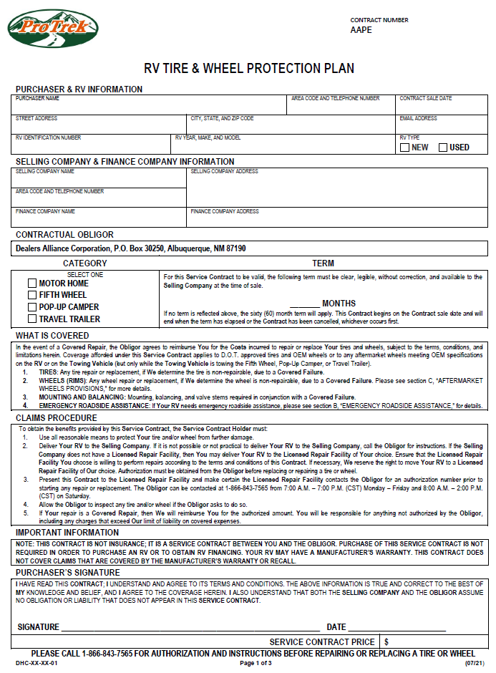
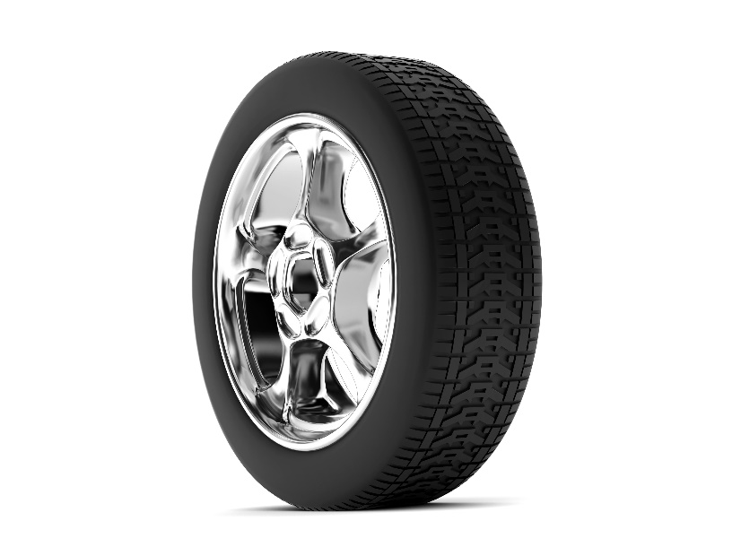
RV – TIRE AND WHEEL PROTECTION
Tire and Wheel Eligibility
New – up to 1 year and less than 1,001
Used – any age, any mileage (no limit)

Slide 107
RV – TIRE AND WHEEL PROTECTION
Tire and Wheel Terms
12, 24, 36, 48, 60, 72, 84-month terms
Towing Vehicle Coverage
Coverage afforded under this service contract applies to D.O.T. approved tires and OEM wheels or to any aftermarket wheels meeting OEM specifications on the RV or on the towing vehicle (but only while the towing vehicle is towing the fifth wheel, pop-up camper, or travel trailer)

Slide 108
RV – TIRE AND WHEEL PROTECTION
Tires: Any tire repair or replacement, if we determine the tire is non-repairable, due to a covered failure.
Wheels (rims): Any wheel repair or replacement, if we determine the wheel is non-repairable, due to a covered failure. Please see section C, “AFTERMARKET WHEELS PROVISIONS,” for more details.
Mounting and balancing: Mounting, balancing, and valve stems required in conjunction with a covered failure

Slide 109
RV – TIRE AND WHEEL PROTECTION
Emergency Roadside Assistance
Towing assistance: If your RV or towing vehicle is disabled and in need of a tow, roadside services will dispatch a towing provider to your location
Flat tire assistance: If your RV or towing vehicle has a flat tire, roadside services will dispatch a service provider to remove the flat tire and replace it with your properly inflated spare tire

Slide 110
Recreational Vehicle Theft

Slide 111
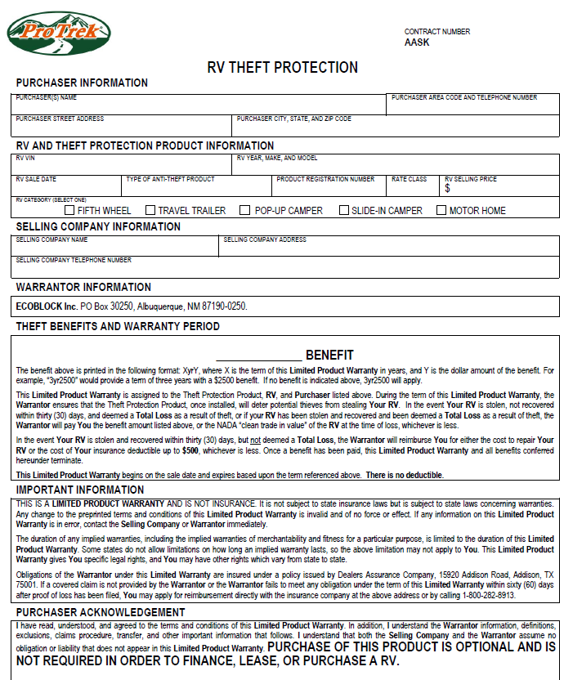
RV – THEFT
Option 1
Term: 2-Year
$1,000 benefit if stolen and not recovered
$500 benefit toward insurance deductible

Slide 112
RV – THEFT
Option 2
Term: 3-Year and 5-Year
$2,500 benefit if stolen and not recovered
$500 benefit toward insurance deductible

Slide 113
RV – THEFT
Option 3
Term: 3-Year and 5-Year
$5,000 benefit if stolen and not recovered
$500 benefit toward insurance deductible

Slide 114


RV – THEFT ADVERT
Use whatever theft product you want!

Slide 115
RV – THEFT
THIS PRODUCT CANNOT
BE OFFERED IN NEW YORK

Slide 116
Recreational Vehicle Interior Exterior

Slide 117
INTERIOR EXTERIOR OPTIONS & TERMS
Bronze – Silver – Gold – Platinum
New – Up to 1 year old, any mileage
Terms – 12, 24, 36, 48, 60, 72, 84, 96, 108 and 120 months
Used – any age, any mileage
Terms – 12, 24, 36, 48, 60, 72 and 84 months
For illustrative purposes only – image is the property of its respective owner

Slide 118
INTERIOR EXTERIOR LIMITS OF LIABILITY
Bronze – $5,000 total for interior exterior combined
Silver – $5,000 total for interior exterior combined
Gold – $4,000 exterior and $2,000 interior
Platinum – $10,000 total for interior exterior combined
For illustrative purposes only – image is the property of its respective owner

Slide 119
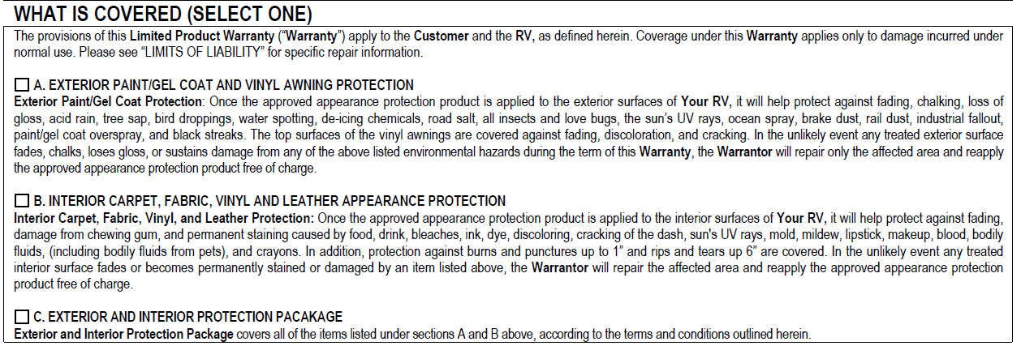
INTERIOR EXTERIOR – OPTIONS
Bronze – interior exterior combined
Silver – Gold – Platinum
On each contract, the customer has a choice of interior only, exterior only, or both
For illustrative purposes only – images are the property of their respective owners

Slide 120
BRONZE EXTERIOR PAINT PROTECTION
Help protect your RV’s exterior from:
Fading, chalking, loss of gloss
Water spotting, acid rain, tree sap
Bird droppings, industrial fallout, road salt
All insects including love bugs if removed within two days of contact
For illustrative purposes only – image is the property of its respective owner

Slide 121
BRONZE INTERIOR CARPET, FABRIC, VINYL & LEATHER
Help protect your RV’s interior from:
Fading or damage from chewing gum
Stains from:
Food, drink, ink, dye
Lipstick, makeup, crayons
Urine, blood, vomit
Oil-based stains, cigarette burns
Punctures up to ¼ inch
Rips and tears up to 1 inch
Fading or discoloration of leather
For illustrative purposes only – image is the property of its respective owner

Slide 122
SILVER EXTERIOR PAINT PROTECTION
Help protect your RV’s exterior from:
Fading, chalking, loss of gloss
Water spotting, acid rain, tree sap
Bird droppings, industrial fallout, road salt
All insects including love bugs if removed within two days of contact
Protects vinyl awning from: fading, cracking, discoloration
For illustrative purposes only – image is the property of its respective owner

Slide 123
SILVER INTERIOR CARPET, FABRIC, VINYL & LEATHER
Help protect your RV’s interior from:
Fading or damage from chewing gum
Stains from:
Food, drink, ink, dye
Lipstick, makeup, crayons
Urine, blood, vomit
Oil-based stains, cigarette burns
Punctures up to ¼ inch
Rips and tears up to 1 inch
For illustrative purposes only – image is the property of its respective owner

Slide 124
GOLD EXTERIOR PAINT PROTECTION
Help protect your RV’s exterior from:
Fading, chalking, loss of gloss
Water spotting, acid rain, tree sap
Bird droppings, industrial fallout, road salt
All insects including love bugs if removed within two days of contact
De-icing chemicals, the sun’s UV rays
Paint/gel coat overspray, black streaks
NOTE: No vinyl awning protection on Gold form
For illustrative purposes only – image is the property of its respective owner

Slide 125
GOLD INTERIOR CARPET, FABRIC, VINYL & LEATHER
Help protect your RV’s interior from:
Fading or damage from chewing gum
Stains from:
Food, drink, ink, dye
Lipstick, makeup, crayons
Blood, bleaches, discoloring
Mold, mildew
Bodily fluids (including bodily fluids from pets)
Burns & punctures up to 1 inch (increase from ¼ inch)
Rips & tears up to 6 inches (increase from 1 inch)
For illustrative purposes only – image is the property of its respective owner

Slide 126
PLATINUM EXTERIOR PAINT PROTECTION
Help protect your RV’s exterior from:
Fading, chalking, loss of gloss
Water spotting, acid rain, tree sap
Bird droppings, industrial fallout, road salt
All insects including love bugs if removed within two days of contact
De-icing chemicals, the sun’s UV rays
Ocean spray, brake dust, rail dust
Paint/gel coat overspray, black streaks
Protects vinyl awning from: fading, cracking, discoloration
For illustrative purposes only – image is the property of its respective owner

Slide 127
PLATINUM INTERIOR CARPET, FABRIC, VINYL & LEATHER
Help protect your RV’s interior from:
Fading or damage from chewing gum
Stains from:
Food, drink, ink, dye
Lipstick, makeup, crayons
Blood, bleaches, discoloring
Mold, mildew
Bodily fluids (including bodily fluids from pets)
Burns & punctures up to 1 inch
Rips & tears up to 6 inches
For illustrative purposes only – image is the property of its respective owner

Slide 128
RV – INTERIOR EXTERIOR
THIS PRODUCT CANNOT
BE OFFERED IN
NEW YORK or FLORIDA

Slide 129
Q & A

Slide 130
Thank You

