Slide 2

INTRODUCING: iA AMERICAN TRAINING INSTITUTE!

Slide 3

TRAINING INSTITUTE
INTRODUCTION
A leader in automotive training

Slide 4
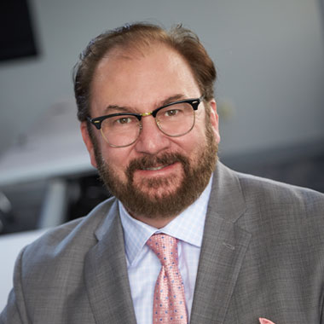
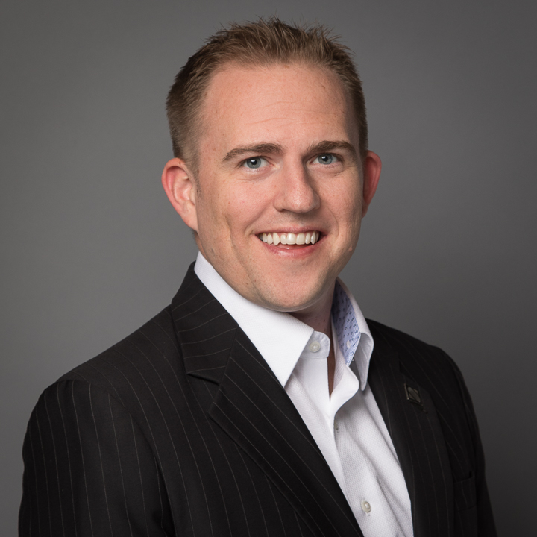
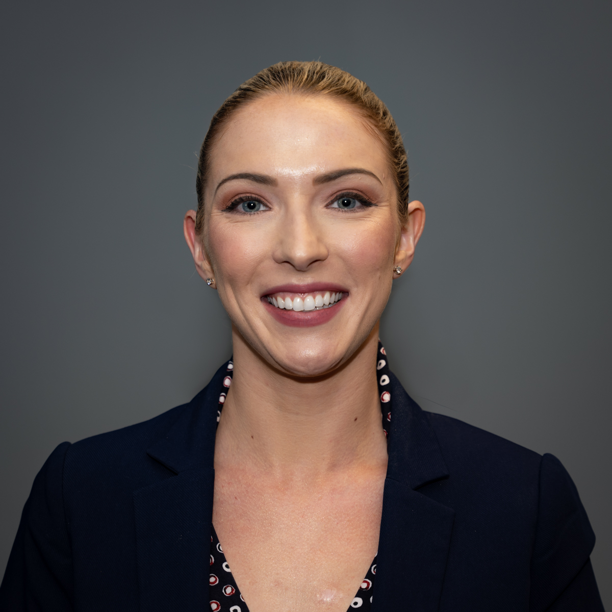


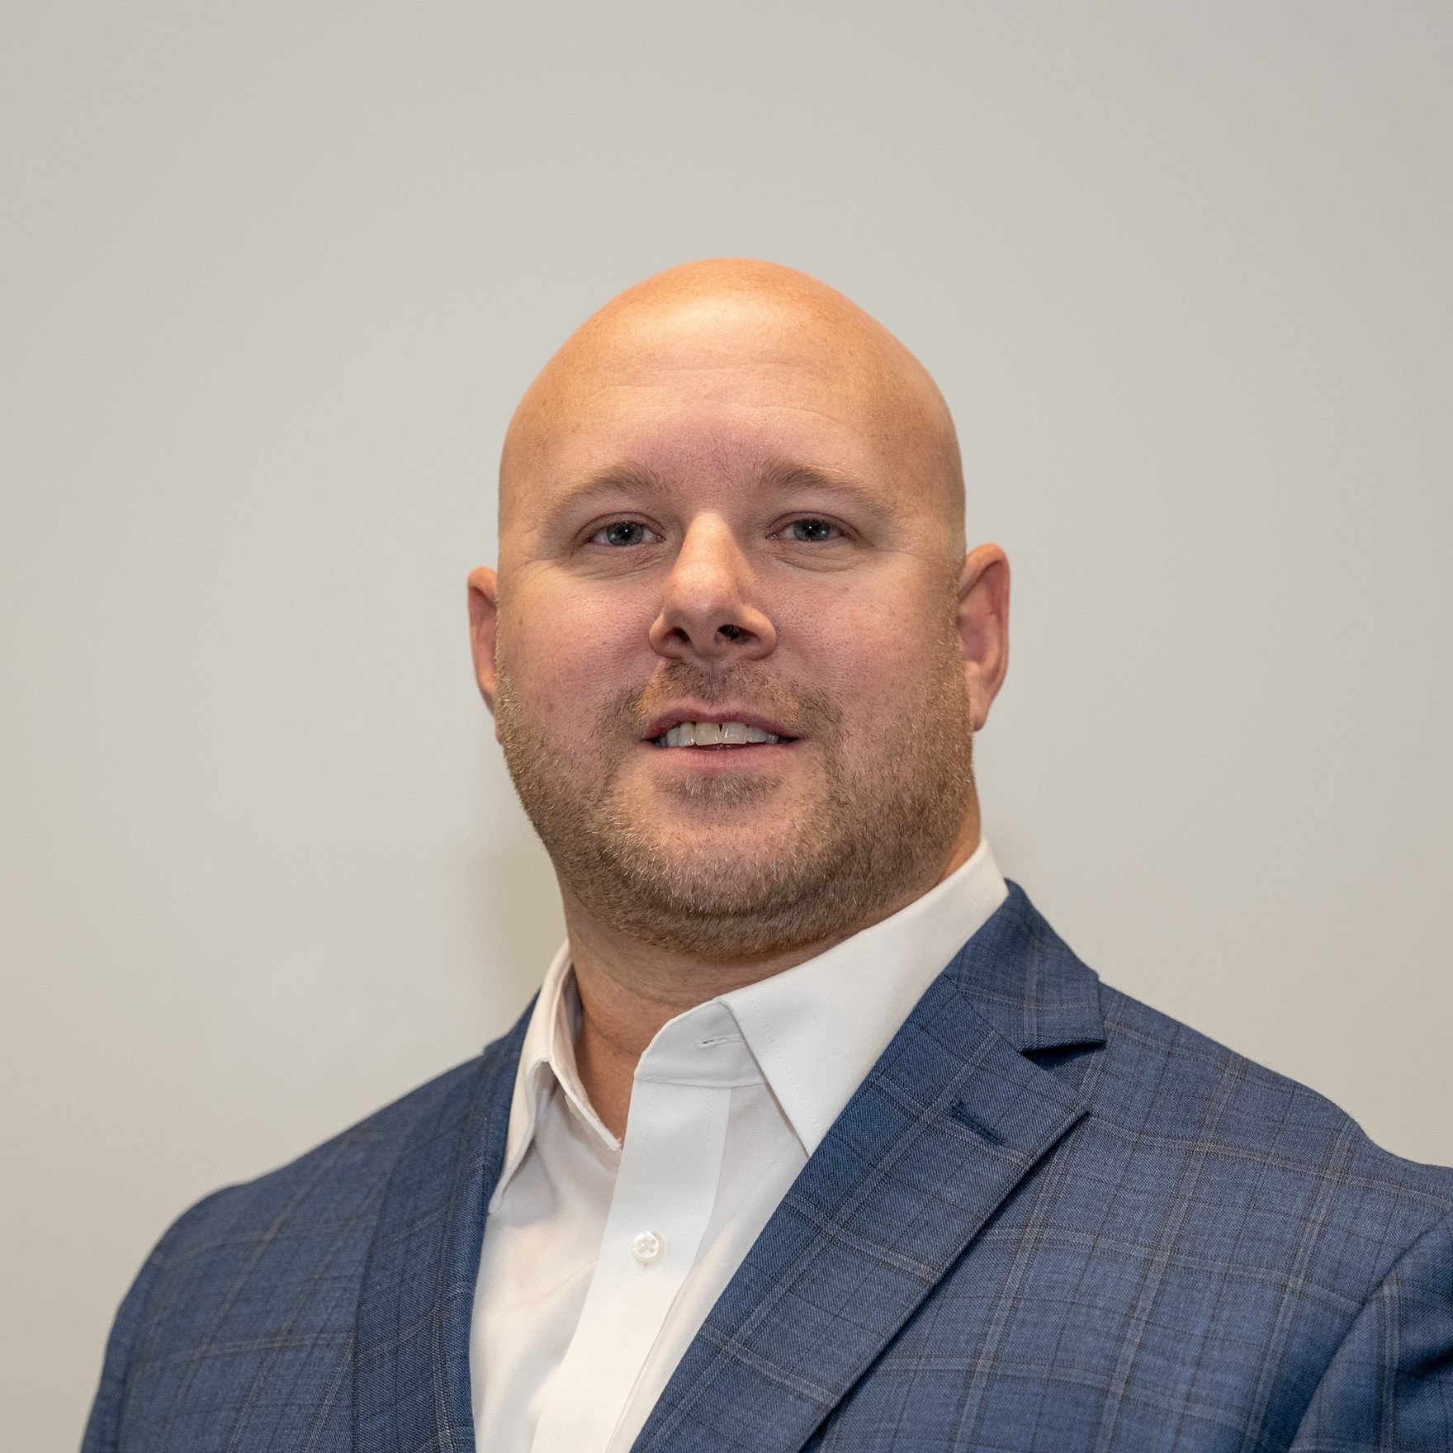
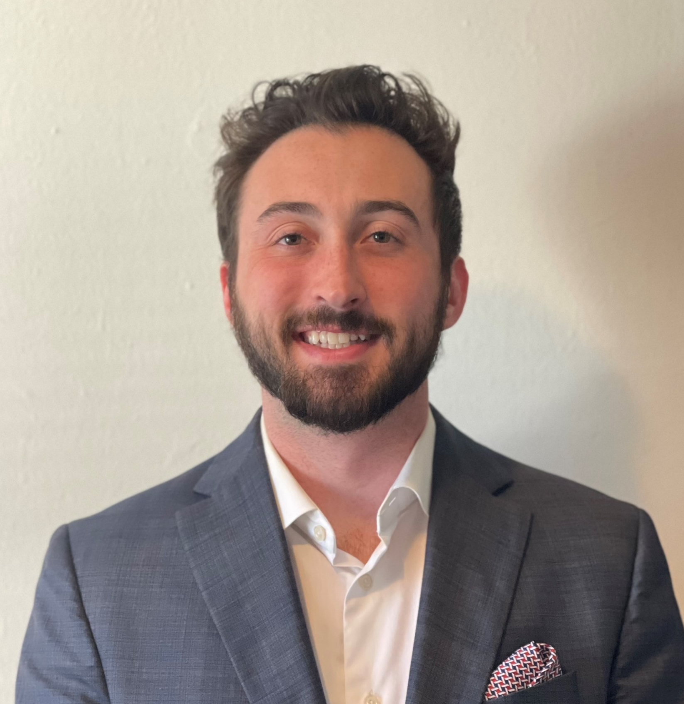
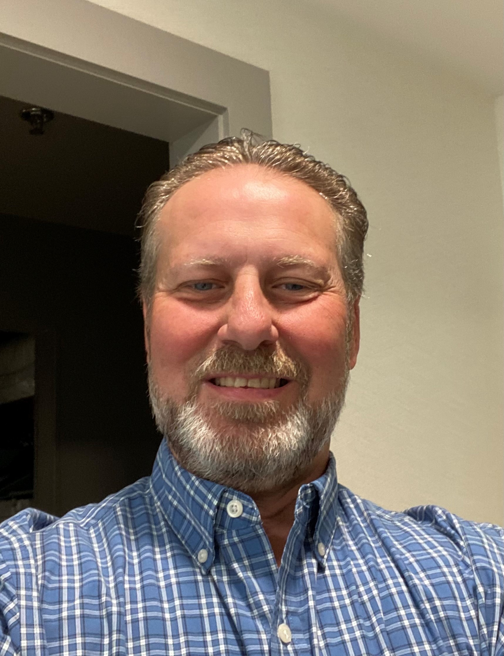
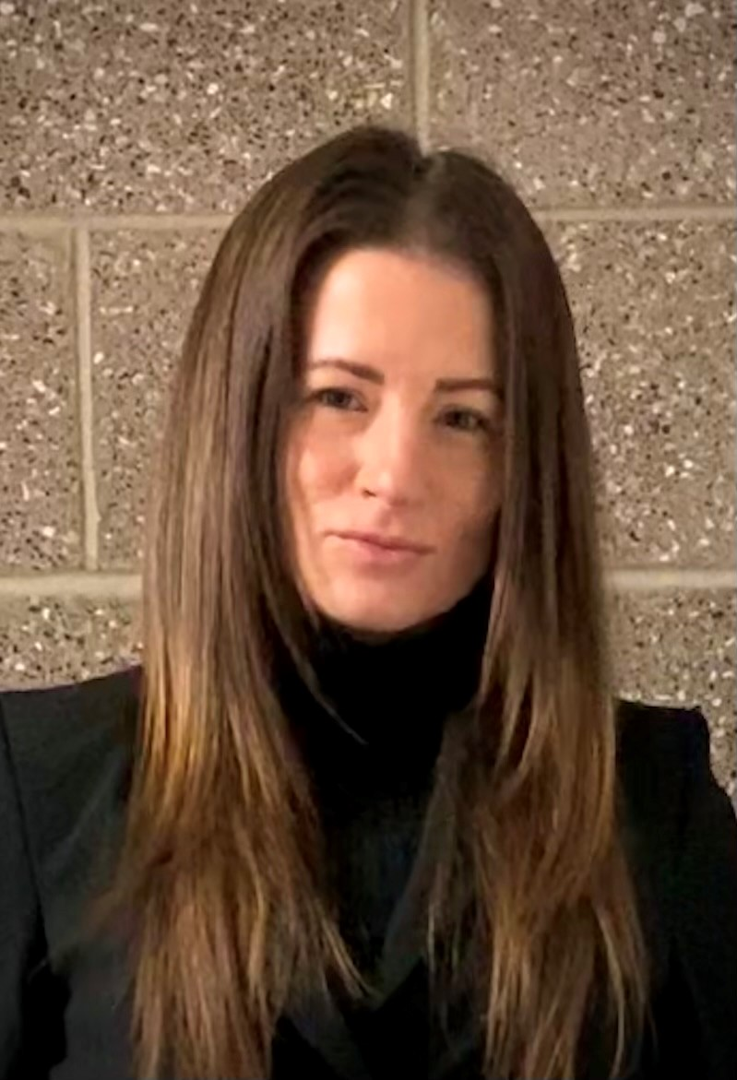
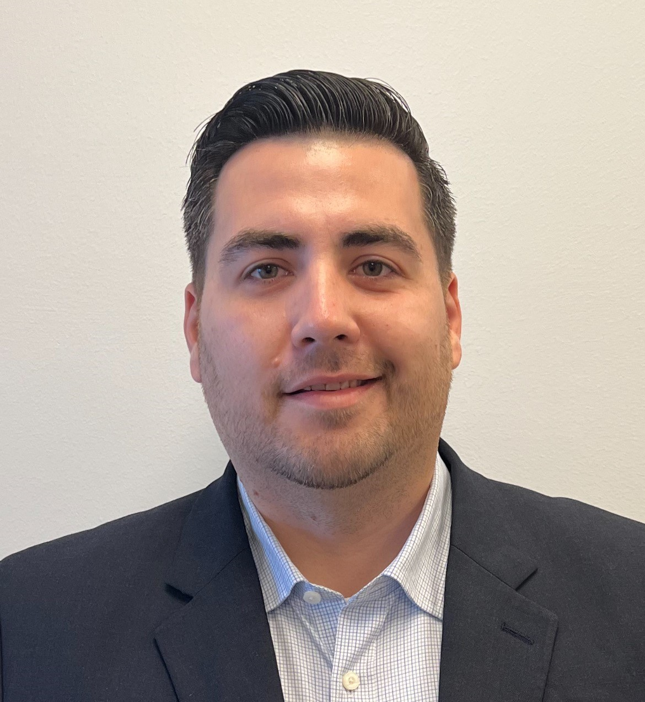
Training & Development Team
Mike Holliman National Director of Training & Academics
Kevin Quinn Lead Training & Development Specialist
Laura Rowland Training & Development Specialist
Arielle Vaughn Training & Development Specialist
Chase Marshall Training & Development Specialist
Ian Vandenbark Training & Development Specialist
Carter Krejci Training & Development Specialist
Austin French Training & Development Specialist
Shelly Liggett Training & Development Specialist
Tyler Williams Training & Development Specialist

Slide 5
Training Offerings
T.U.S.K. F&I School
Locations:
Las Vegas headquarters every month, beginning in April
Austin and Oklahoma City locations every other month
Hotel blocks available for Austin and Las Vegas classes
Can be taught on-location/in-dealership
One day F&I Power Boost

Slide 6

We will always do the right thing and promise to uphold the highest level of integrity and professionalism in the F&I office.
This is the only F&I school to uphold the EFI Code of Conduct.
We will not engage in fraudulent practices.
We will provide full disclosure of all product information, RISC, and lease contracts to every customer.
We will practice zero tolerance in discrimination.
CODE OF CONDUCT
As professional members of the EFI community, we are committed to constant improvement by educating ourselves on the laws and rules of our industry. We will strive to uphold the following rules, as we encourage and empower others in the profession to do the same.
We are committed to diligence in the training and self-education of all laws, rules, and regulations of the F&I office, and the legal ramifications if we do not abide by them.
We will maintain a customer-first mindset, seeking to understand and meet the customer’s needs above all else and conducting ourselves with an approachable demeanor to aid in creating a positive customer experience.
Ethical F&I Managers (EFI)
We will continually work to know and understand every document in full, including but not limited to: all dealer agreements regarding the F&I office, all finance company provisions and rate sheets, and all product contracts and the information therein.

Slide 7
FINANCE & INSURANCE
F&I OF TODAY
The most significant changes in F&I in the past five years:
The most significant changes in F&I
moving forward:
Customers’ self-education and awareness
State and Federal legislation
Technology in the dealership
Scrutiny from the FTC, CFPB, ABA, and state agencies
Social media
Online reviews
No physical office – only virtual, mobile, online transactions
Digital paperwork
Higher customer expectations
Necessity to decrease transaction time

Slide 8
FINANCE & INSURANCE
The Science of F&I
Can I?
Will I?
The “Can I?” question deals with money and the customer’s budget.
The “Will I?” question deals with a customer’s emotion.
WIIFM Society

Slide 9
What does a customer already know by the time they visit the dealership?
What does the business manager need to help them with?
Can I?
Will I?
MONEY
EMOTION

Slide 10
Training Offerings
T.U.S.K. Sales Training
New Hire Sales Training
Hybrid F&I Training
Phone, Internet & BDC Training
Leadership & Sales Management Training
One-Day Sales Power Boost
Two-Day Sales Reset
On-location support

Slide 11
THANK YOU

