Slide 2
WELCOME

Slide 3

HOW TO LEAD ON THE BATTLEFIELD OF BUSINESS

Slide 4

Leadership

Slide 5
12 Principles of Leadership
A commander will command

Slide 6
12 Principles of Leadership
Qualities of a great general

Slide 7
12 Principles of Leadership
Model leaders

Slide 8
12 Principles of Leadership
Napoléon

Slide 9
12 Principles of Leadership
Being supple

Slide 10
12 Principles of Leadership
Is it important to be popular?

Slide 11
12 Principles of Leadership
Dominate vs. domineer

Slide 12
12 Principles of Leadership
Selection

Slide 13
12 Principles of Leadership
Prima donnas

Slide 14
12 Principles of Leadership
Horses and tanks

Slide 15
12 Principles of Leadership
Get shot at

Slide 16
12 Principles of Leadership
Fight

Slide 17

iA American Training Institute

Slide 18

iA American Training Institute

Slide 19

iA American Training Institute

Slide 20
What People Are Saying About iAATI
“That was only 13 minutes? My customers and our salespeople are going to love this *&%$!” – JR
“Wow! This is so simplified. I feel like I can actually implement this immediately!” – Joshua
“I always heard these [trainings] were boring, outdated, and gave useless information. But this was engaging and interactive. Thank you!” – Maurice
“Putting myself through [F&I School] without an F&I offer was a tough risk to take, but you have explained this process so well that I am confident if I stick to it, I will succeed!” – Keri
(Keri had a job interview during F&I School and got the job. She started the following Monday.)

Slide 21
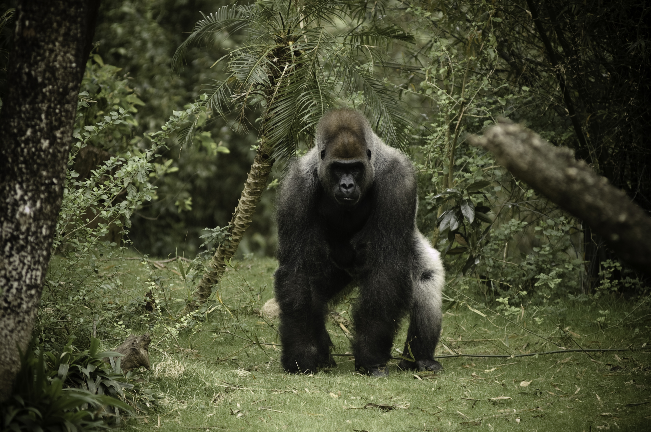
The Competition

Slide 22

iA American

Slide 23
Q&A

