Slide 2
WELCOME

Slide 3
Ancillary

Slide 4

Tire & Wheel Protection
Tire and Wheel
Tire and Wheel with curb cosmetic
Tires Only
Tire Replacement Only
Cosmetic Only
1-7 year term contracts
Claims pay cost plus 10% on tires, 20% on wheels.
Standard – Tire Repair Replace with $2,000 aggregate
Premium – Tire Repair Replace with $2,000 aggregate and Wheel Repair Replace with $2,500 aggregate
Elite – Tire Repair Replace with $3,000 aggregate limit and Wheel Repair Replace with $4,000 aggregate
Elite Plus –Tire Repair Replace with $4,000 aggregate limit and Wheel Repair or Replace with $6,000 aggregate
Claims pay MSRP on tires and wheels.

Slide 5

Key Replacement
Lost, stolen, or destroyed
Lockout service
Roadside assistance
1-7 year term options
Standard Coverage $399 per year benefit
Luxury Coverage $799 per year benefit
Standard Coverage $450 per year benefit
Premium Coverage $850 per year benefit
Elite Coverage $1,250 per year benefit

Slide 6

Dent & Door Ding Protection
Protects against minor door dings and small dents
No need for expensive and time-consuming body shop repair
Up to 4” in diameter
Use dealer’s local PDR company
1-7 year coverage options
Vertical/horizontal
Hail damage coverage options

Slide 7
Theft
Multiple programs
$1,000 Preload
$2,500 - $500
$1,500 - $1,000 - $1,000 - $2,600 Trip Interruption
$3,000 - $2,000 - $1,000 - $2,600 Trip Interruption
One programs offers five different term/benefit options:
2-yr. – $1,000
3-yr. – $2,500 or $5,000
5-yr. – $3,000 or $5,000
Offers $1,000 reimbursement for insurance deductible
Vehicle Replacement Rebate pays an additional $1,000 if customer purchases a replacement vehicle from selling dealer prior to submitting a claim; also offers trip interruption
7

Slide 8


Theft
Six-point window etching product
Quickly and easily identifies vehicle
Theft deterrent decal
Permanent tamper-resistant, six-point label product
After label has been removed, leaves mark on vehicle visible only by UV light
Theft deterrent decal
Use any theft product: GPS or alarm

Slide 9

Windshield Repair or Replacement
Easily recognizable benefit that adds substantial value to the vehicle
Covers stars, chips, or cracks to the front windshield caused by road hazards
Repair only and repair or replacement plans available

Slide 10
Windshield Repair or Replacement
Windshield Repair
Windshield Repair Replace – Aftermarket
Windshield Repair Replace – OEM/Recal
Crystal Fusion Repellency
Crystal Fusion Windshield Repair
Crystal Fusion Windshield Repair Replace
Crystal Fusion Windshield Repair Replace OEM/Recal

Slide 11

Crystal Fusion Windshield Protection
Durability
Clarity
Cleanliness
Safety

Slide 12

Super Polysteel Appearance Protection
Wax-On Wax-Off
Advanced formula of cross linking amino functional polymers
Foam-On Rinse-Off
High-volume dealers and RV dealers
Hydrosilic Ceramic Spray-On Buff-In
Ceramic is the big buzz in the industry

Slide 13
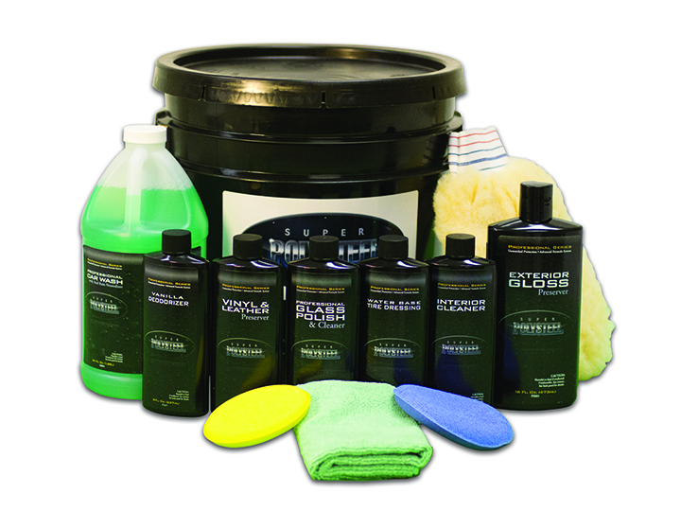
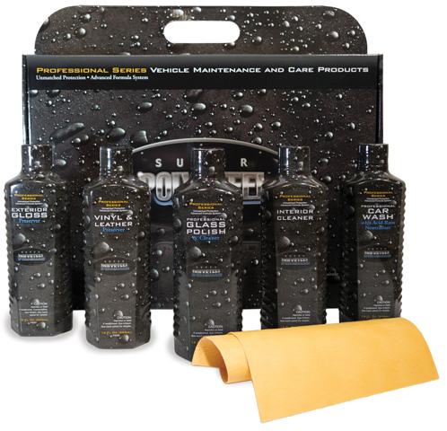
Super Polysteel Appearance Protection

Slide 14
Super Polysteel Appearance Protection
Interior/Exterior
Interior/Exterior with Rips and Tears
Interior/Exterior with Rips, Tears, Burns, and Rental Benefit
Programs with Floormat Coverage
Programs with Antimicrobial Protection
1-7 year terms
Multiple program options
Polysteel brand
Chemical agnostic

Slide 15



Multi-Shield Protection

Slide 16
Multi-Shield Protection
Tire and Wheel, Dent, Windshield, Roadside

Slide 17
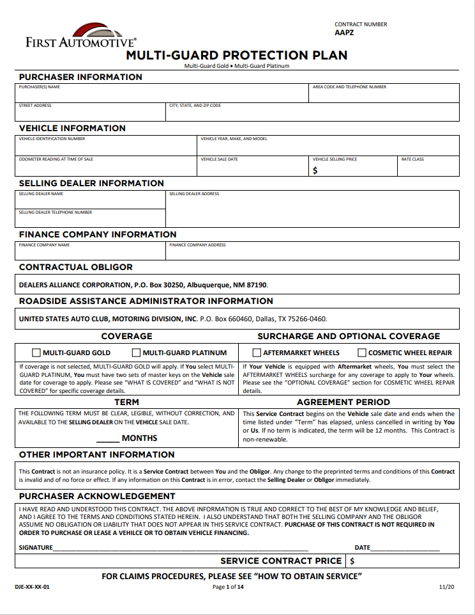
Multi-Guard – Deductible and Terms?
$0 deductible
12, 24, 36, 48, 60, 72, 84 terms

Slide 18
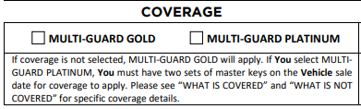
Multi-Guard – What is covered?
Multi-Guard Gold
Tires and wheels due to Road Hazard
Paintless Dent Repair
Windshield Repair
Rental Car Reimbursement
Emergency Towing
Emergency Roadside Assistance

Slide 19
Multi-Guard Platinum – What is covered?
Multi-Guard Platinum
Includes Multi-Guard Gold
Key Replacement
Travel Interruption Reimbursement

Slide 20
Q&A

